Slide 1

Patient Encounter Cost and Risk Analysis in Healthcare Systems
This presentation outlines a comprehensive data analytics project aimed at drawing actionable insights into patient demographics, procedure trends, and key factors driving uncovered costs.
By- Utkarsh Raj

Slide 2
Project Overview: Uncovering Financial Risks Insights in healthcare Organizations
Conducting comprehensive analysis of Patient Encounters, Costs, and Coverage Gaps for Financial Risk Mitigation in Healthcare.
Key Challenge
Our Aim
Actionable Insights
Managing rising healthcare costs and financial risks from frequent high-cost encounters and payer coverage gaps.
Drawing insights on patient encounters, procedure costs,
and coverage gaps to improve healthcare cost management and operational efficiency.
Actionable steps for cost control, risk mitigation, and better resource allocation based on insights.

Slide 3
Dataset Description
Tables:
ENCOUNTERS
ORGANISATION
PAYERS
Contains Patients Encounter related data like Encounter class, Payer, Total claim cost, Coverage gap etc.
Contains Hospital details : Name, Adress, City , state , Geographical coordinates.
Contains Payer’s details : Name, Adress, City , state , ZIP, Phone.
PROCEDURES
PATIENTS
Contains Procedure related data like Procedure timing, Patient, Encounter, Description, Base cost etc.
Contains Patients information:
Name, Birth Date, Death Date, Marital status, Ethnicity etc.

Slide 4
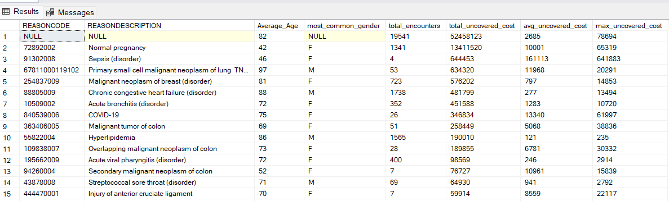
Evaluating Financial Risk by Encounter Outcome
We determine which ReasonCodes lead to the highest financial risk based on the total uncovered cost (difference between total claim cost
and payer coverage).
Objective
Observations :
Identify ReasonCodes with highest financial risk from uncovered costs.
Excluding missing Reason code, Reason code with highest Total Uncovered cost is :
72892002 – Normal Pregnancy
Combine patient demographics and encounter outcomes.
On an average females of age around 42 years are most vulnerable
Top 2 Reason codes with highest number of Encounters :
1. 88805009 – Chronic Congestive heart failure(disorder)
2. 55822004 - Hyperlipidemia

Slide 5
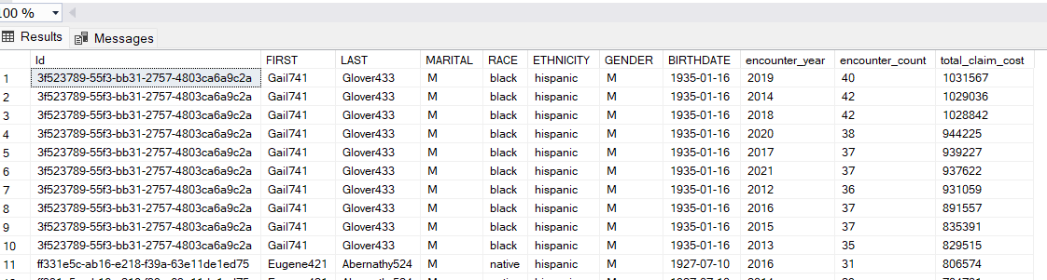
Identifying Patients with Frequent High-Cost Encounters
Identify patients who had more than 3 encounters in a year where each encounter had a total claim cost above a certain threshold (e.g., $10,000).
Objective
Observations :
Gail Glover had most frequent High-Cost encounters , with highest number of
encounter in
2014 & 2018 – 42 times
Identify Patients with most frequent encounters
Finding Total Cost of those encounter
Total cost of these encounters : 2014 – $ 1029036
2018 - $ 1028842
Overall count of encounters and total cost between 2012 - 2021
Total Encounters- 381
Total cost – $ 9,398,041

Slide 6
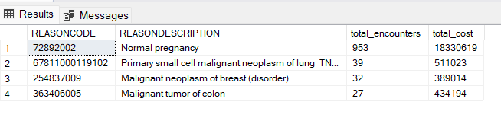
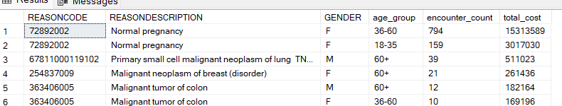
Identifying Risk Factors Based on Demographics and Encounter Reasons
Analyze the top 3 most frequent diagnosis codes (ReasonCodes) and the associated patient demographic data to understand which
groups are most affected by high-cost encounters.
Objective
Observations :
Top 3 most frequent Reason codes :
72892002 – Normal Pregnancy
67811000119102 – Primary small cell malignant neoplasm of lung
254837009 - Malignant neoplasm of breast ( disorder)
Identify top 3 most frequent Reason codes
Combine patient demographics to understand which groups are
most affected
Total cost of these Reason codes :
Normal Pregnancy : $ 18330619
Primary small cell malignant neoplasm of lung : $ 511023
Malignant neoplasm of breast ( disorder) : $ 389014
Most affected groups by these encounters :
Normal Pregnancy : Females of age group 36-60 & 18-35
Primary small cell malignant neoplasm of lung : Males above 60 years
Malignant neoplasm of breast ( disorder) : Females above 60 years
Aggregated with only reason codes
Aggregated with age group + Gender

Slide 7
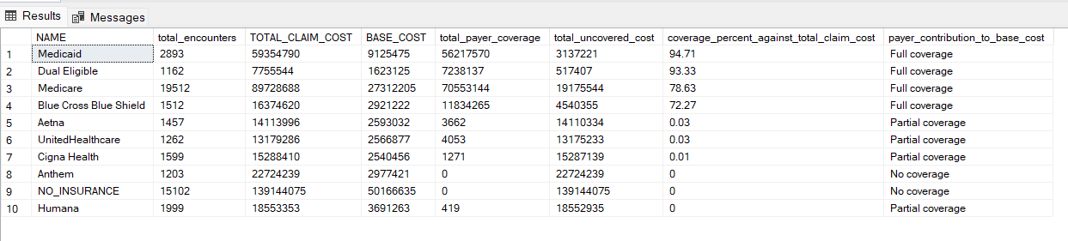
Assessing Payer Contributions for Different Procedure Types
Analyze payer contributions for the base cost of procedures and identify any gaps between total claim cost and payer coverage.
Objective
Observations :
Payer with highest coverage against Total claim cost :
Medicaid : coverage percent – 94.71%
( Full coverage against base cost)
Find out how much payer contributes against base cost
Uncover gaps between Total claim cost and payer coverage.
Payers with 90 %+ Coverage against Total claim cost :
Medicaid – 94.71 %
Dual Eligible – 93.33 %
Payers with Partial coverage or no coverage against base cost :
Aetna : 0.03 % against total claim
United Health Care : 0.03 % against total claim
Cigna Health : 0.01 % against total claim
Humana
Anthem ( no coverage)

Slide 8
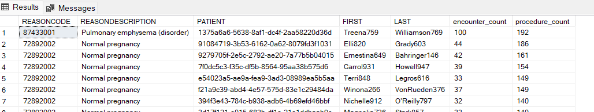
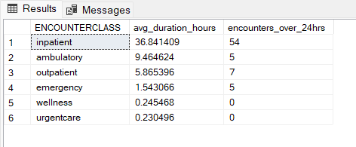
Identifying Patients with Multiple Procedures Across Encounters
Find patients who had multiple procedures across different encounters with the same ReasonCode.
Observations :
Top 3 Patients having multiple procedures across different encounters with same reason code:
Treena Williamson – 192 procedures across 100 encounters for Pulmonary emphysema
Eli Grady – 186 procedures across 44 encounters for Normal Pregnancy
Emestina Bahringer – 161 procedures across 42 encounters for Normal pregnancy
Analyzing Patient Encounter Duration for Different Classes
Calculate the average encounter duration for each class (EncounterClass) per organization, identifying any encounters that exceed 24 hours.
Observations :
Inpatient type encounter has highest average duration hours – 36.84 hrs
as well as most numbers of encounters exceeding 24 hours - 54

Slide 9
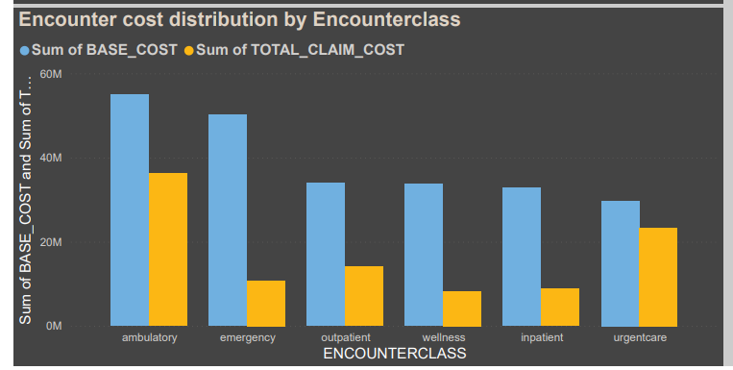
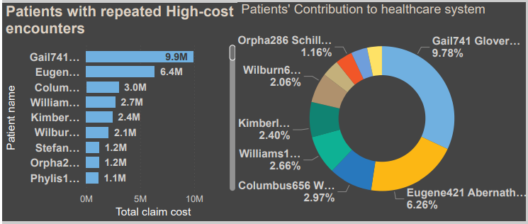
Encounter Cost Distribution by Encounter Class
Examining how base and total claim costs vary across different healthcare
encounter classes like emergency, inpatient, and wellness.
Observations :
Ambulatory type encounter has highest total base cost (~60 M) and Total claim cost (~ 40M)
Analyzing Patient Encounter Duration for Different Classes
Identify patients with repeated high-cost encounters and
highlight their total cost contribution to the healthcare system.
This helps in targeting care management for patients with high healthcare utilization.
Observations :
Ambulatory type encounter has highest total base cost (~60 M) and Total claim cost (~ 40M)

Slide 10
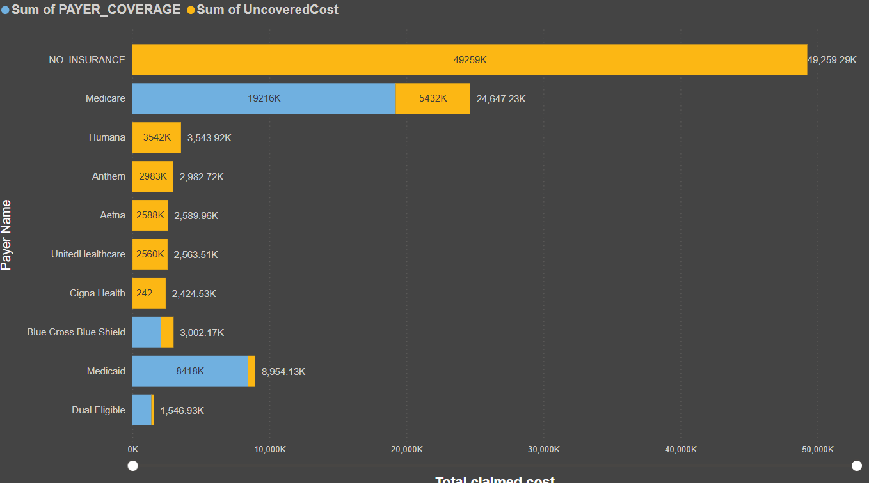
Uncovered Costs by Payer and Reason Code
Assessing financial risks by comparing payer coverage to uncovered costs across various diagnosis or reason codes.
Observations :
Approximately $50 million in total claimed costs remains uninsured, indicating a significant financial risks for patients.
Medicare demonstrates the strongest market presence, covering approximately 78% of the total claimed cost, which amounts to $24 million.
Medicaid emerges as the most effective in mitigating financial risk, achieving approximately 94% coverage of claimed costs, despite its relatively lower market share.

Slide 11
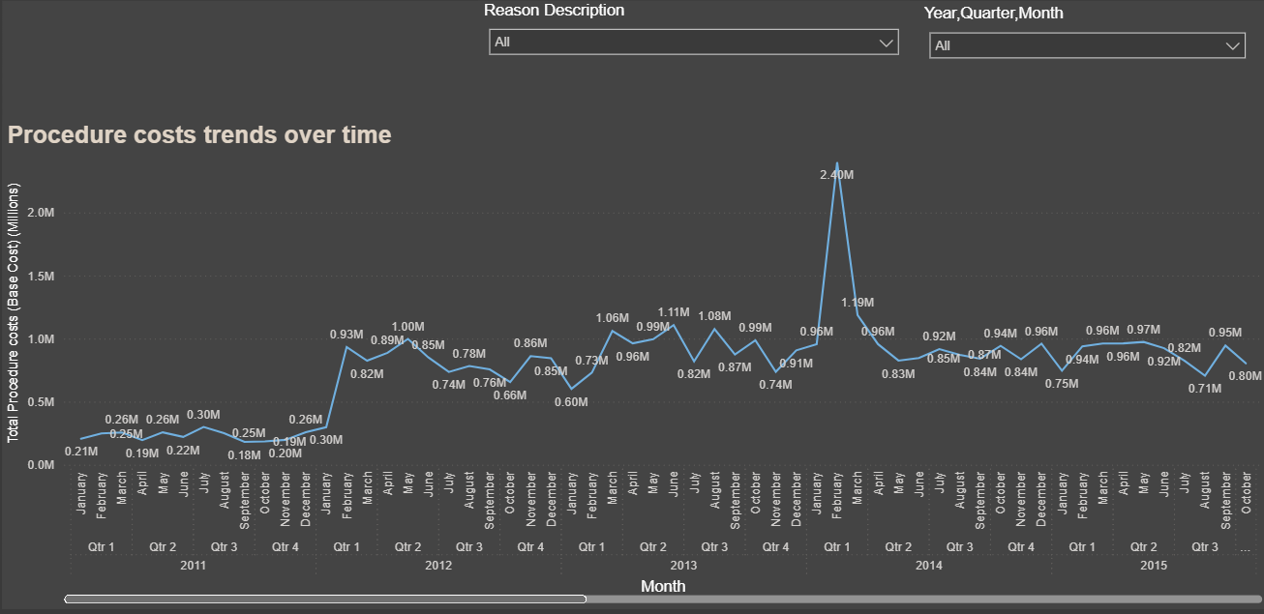
Procedure Cost Trends and Diagnosis Correlation
Analyze procedure cost trends over time and examine their correlation with specific diagnosis codes or medical conditions.
Observations :
Overall, procedure costs remained relatively stable over time, with a noticeable deviation around the first quarter of 2014.
Overall procedure costs nearly doubled around 1st quarter of 2012 but remains relatively stable thereafter.

Slide 12
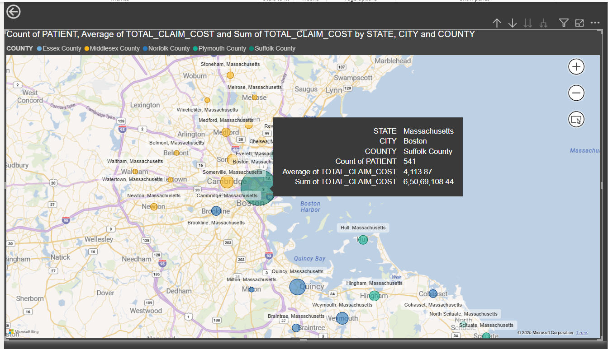
Geographical Analysis of Encounters by Organization and Cost
Map healthcare encounters geographically to identify regions or organizations with high patient traffic and high average encounter costs.
Observations :
Boston city in Suffolk county has highest patient traffic.(~541)
Average encounter cost in Boston = $4113
Total Encounter cost ~ $ 65 million

Slide 13
Key Insights for Managing Healthcare Costs and Mitigating Financial Risks
Due to Payer Coverage Gaps
Normal Pregnancy carries unexpectedly high financial risk
Significant Payer Coverage gaps among major private insurers
Diagnosis code 72892002 (Normal Pregnancy) incurs the highest uncovered costs.
Coverage gaps in pregnancy-related care highlight the financial burden on patients despite the common nature of the condition.
Women around age 42 are most impacted, needing better insurance coverage.
Public payers like Medicaid (94.71%) and Medicare (78%) cover a high proportion of claim costs.
Private insurers offer partial or negligible coverage for high-cost encounters. Leading to significant financial risk for both patients and healthcare providers.
Highlights the need for negotiation and policy reform to improve private payer coverage.
Substantial financial burden from frequent High-Cost patient encounters
Certain Demographics and Diagnoses Amplify Risk Exposure
High-utilization patients like Gail Glover (381 encounters, $9.4M) drive disproportionate costs.
Repeated high-cost encounters significantly impact overall healthcare spending.
Targeted care management can help control costs and reduce financial risk.
High-cost encounters cluster among specific age/gender groups and diagnoses:
Normal pregnancy mainly impacts females aged 18–60.
Primary small cell lung cancer mostly affects males over 60.
Malignant breast neoplasm impacts females over 60.
Tailored insurance products or targeted interventions for these high-risk populations could improve coverage equity and reduce uncovered costs.
Geographic Hotspots for High Encounter Volumes and Costs
Boston (Suffolk County) has the highest patient traffic and high average encounter costs ($4,113 per encounter; total ~$65 million)
Region-specific interventions are essential in areas with high healthcare demand and cost burden to enable better resource allocation and reduce financial risks by addressing significant payer coverage gaps.

Slide 14
END OF PRESENTATION

